Slide 1
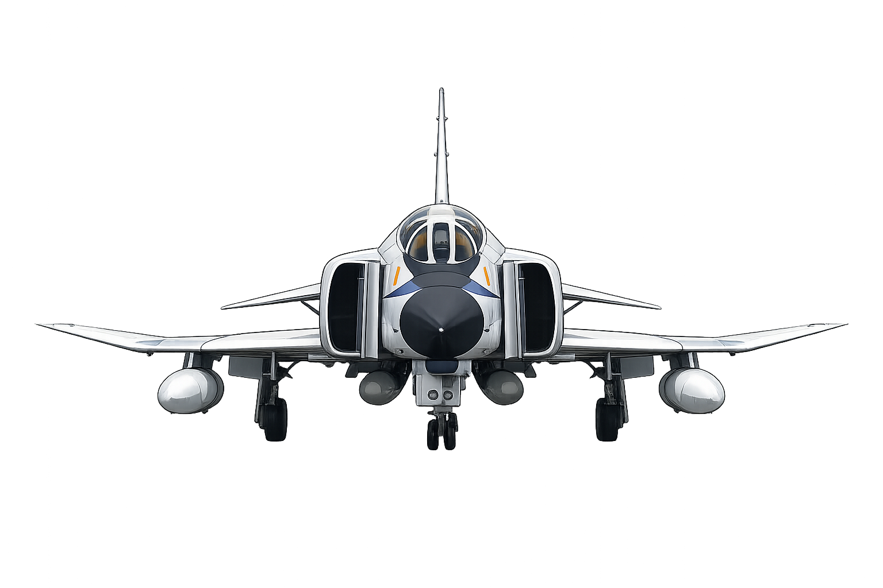
Final Project Robust Flight Control System Design
KOM 501E Control of Systems with
Parametric Uncertainty
Emir Arda Kılıç
504251113
İsmet Erdoğan
040200522
Notes:
Cover

Slide 2
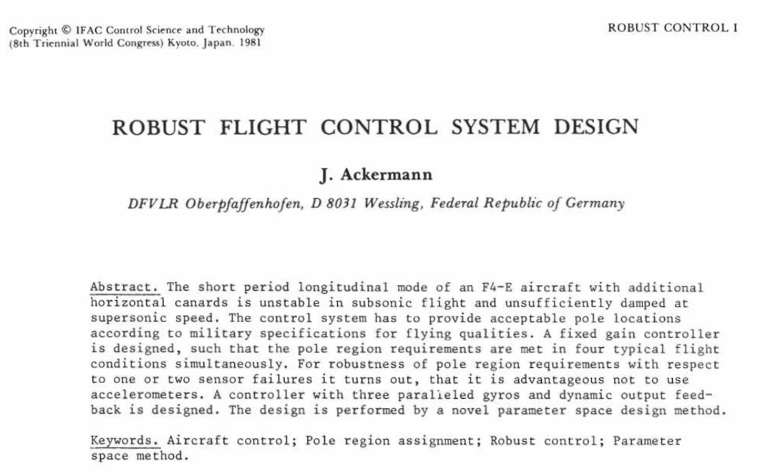
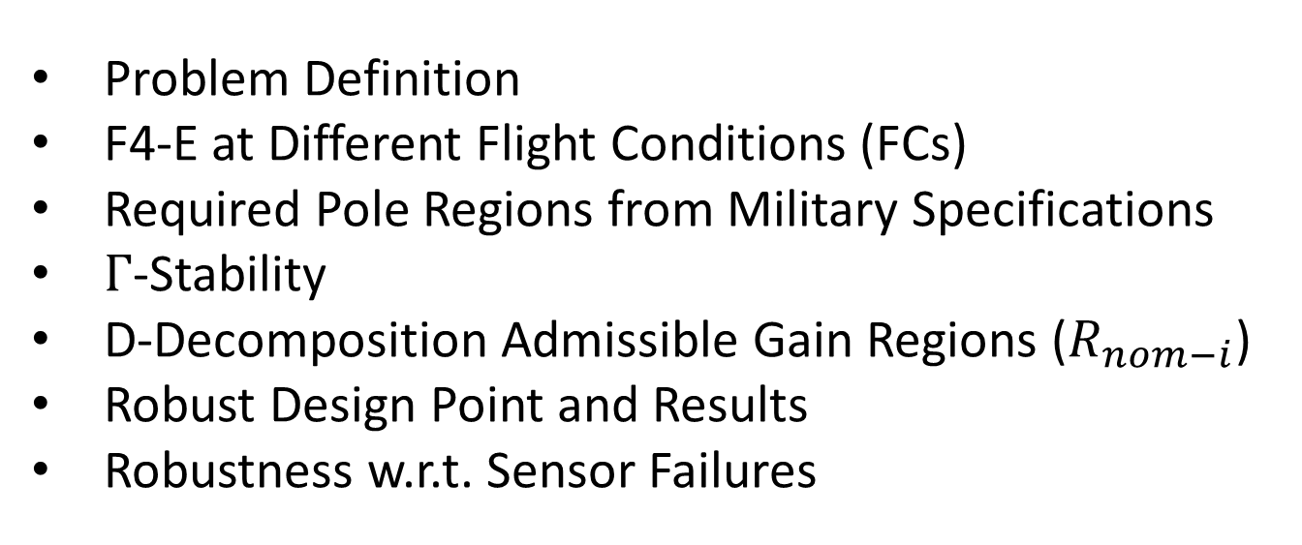
Contents
Problem Definition
F4-E at Different Flight Conditions (FCs)
Required Pole Regions from Military Specifications
$Γ$-Stability
D-Decomposition Admissible Gain Regions ($R_{nom−i}$)
Robust Design Point and Results
Robustness w.r.t. Sensor Failures
Notes:
Contents

Slide 3
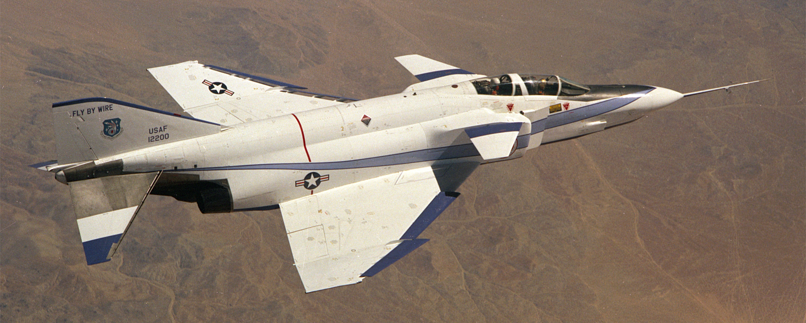
Problem Definition
The short period longitudinal mode of an F4-E aircraft with additional horizontal canards is
unstable in subsonic flight
insufficiently damped in supersonic flight
Horizontal canards destabilizes the aircraft
Design (fixed gain) controller that provide acceptable pole locations according to military specifications for flying qualities in four typical flight conditions simultaneously.
YF-4E: First Fighter Aircraft with Analog Fly-by-Wire
Notes:
Problem Definition (1)

Slide 4
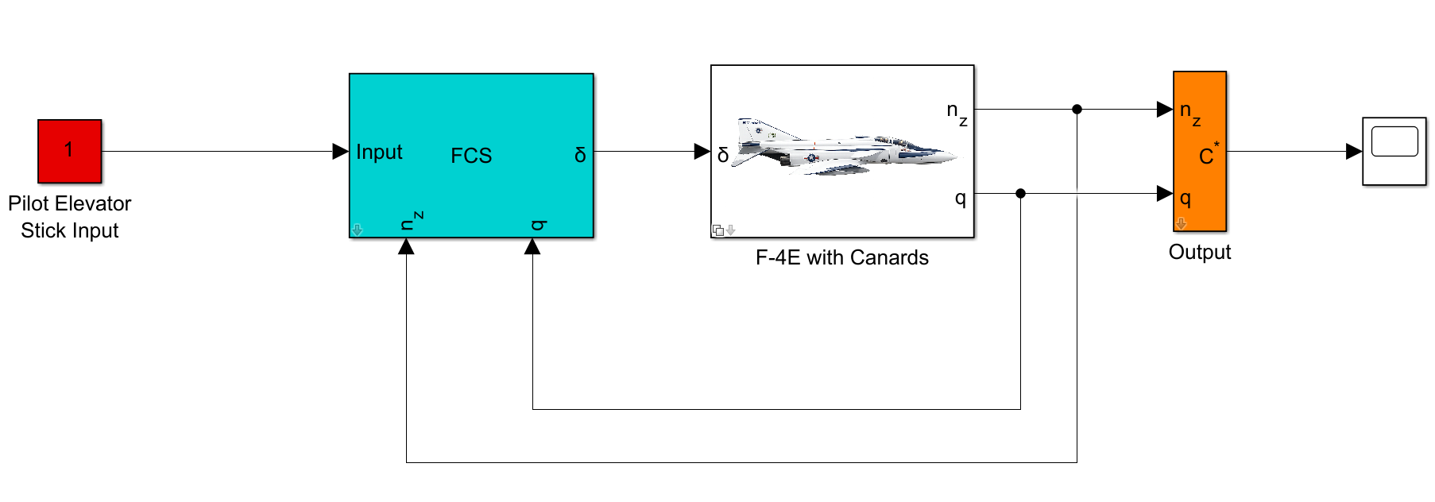
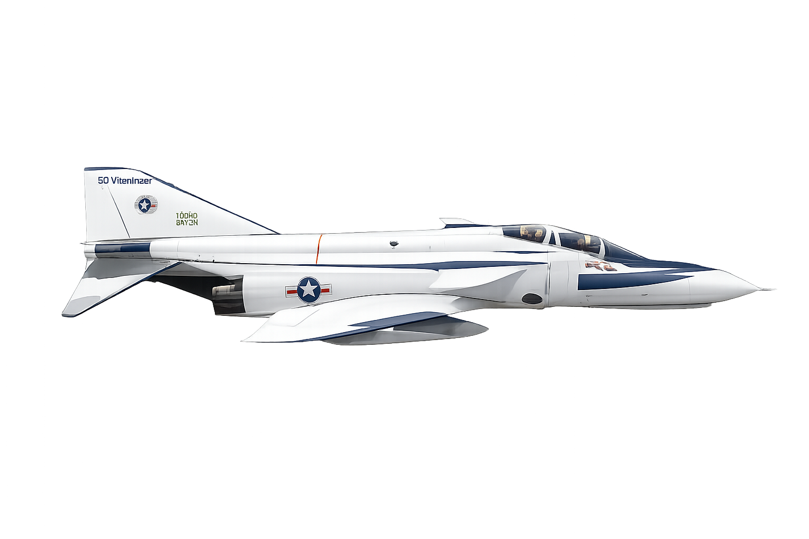

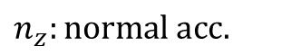
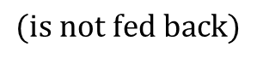
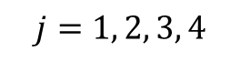
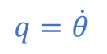
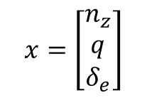
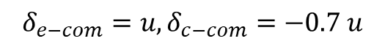
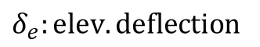
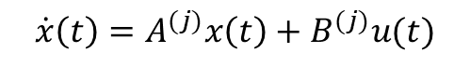

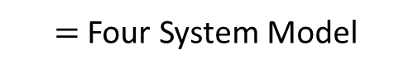


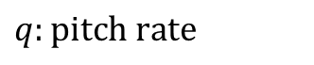

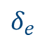
Problem Definition (continued)
Fixed-Gain Controller
Four Flight Condition
Basically state feedback controller
as a flight control system (FCS)
$=$ Four System Model
$$q=\dot{θ}$$
$$\dot{x}\left(t\right)=A^{(j)}x\left(t\right)+B^{(j)}u(t)$$
$$j=1, 2, 3, 4$$
$$V$$
$$θ$$
$$α$$
$$δ_{c}$$
$$δ_{e}$$
$$x=\left[\begin{matrix}n_{z} \\ q \\ δ_{e}\end{matrix}\right]$$
$$n_{z}:normal acc.$$
$$δ_{e−com}=u, δ_{c−com}=−0.7 u$$
$$q:pitch rate$$
$$n_{z}$$
$$δ_{e}:elev. deflection$$
Single Input Problem
$$(is not fed back)$$
Notes:
Problem Definition (2)

Slide 5
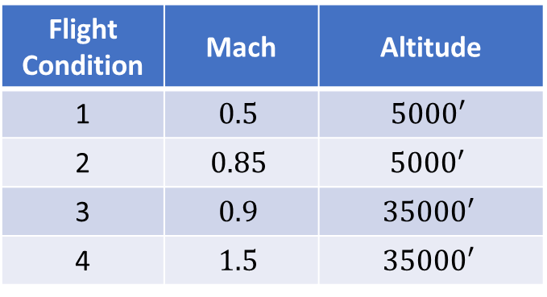
F4-E at Different Flight Conditions
Flight Condition | Mach | Altitude
1 | $$0.5$$ | $$5000′$$
2 | $$0.85$$ | $${5000}^{′}$$
3 | $$0.9$$ | $$35000′$$
4 | $$1.5$$ | $$35000′$$
Actuator Pole
Notes:
F4-E at Different Flight Conditions

Slide 6
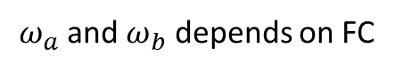
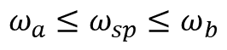
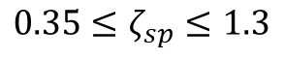
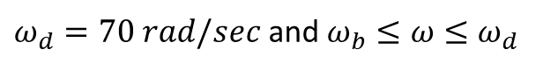
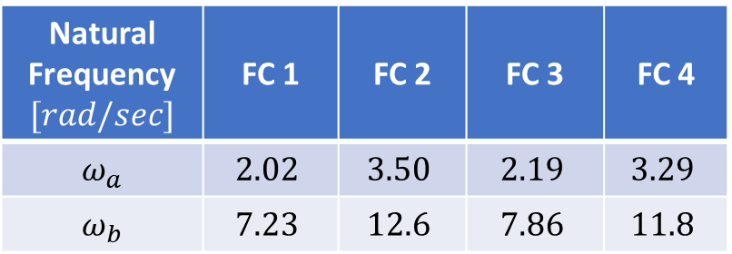
Required Pole Regions from Military Specs.
According to military specifications (MIL-F-8785 C) for flying qualities of piloted airplanes
$$Short Period Mode: \boxed{s^{2}+2ζ_{sp}ω_{sp}+ω_{sp}=0}$$
Restricted Ranges
Natural Frequency $[rad/sec]$ | FC 1 | FC 2 | FC 3 | FC 4
$ω_{a}$ | $$2.02$$ | $$3.50$$ | $$2.19$$ | $$3.29$$
$ω_{b}$ | $$7.23$$ | $$12.6$$ | $$7.86$$ | $$11.8$$
$$0.35≤ζ_{sp}≤1.3$$
$ω_{a}$ and $ω_{b}$ depends on FC
$$ω_{a}≤ω_{sp}≤ω_{b}$$
There are no requirements for the location of additional poles from actuator or feedback dynamics. Quick response is essential for fighter. However, triggering the structural mode frequency should be avoided.
$ω_{d}=70 rad/sec$ and $ω_{b}≤ω≤ω_{d}$
Notes:
Required Pole Regions from Military Specs.

Slide 7
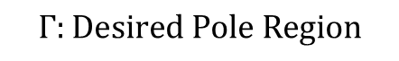
Required Pole Regions from Military Specs. (ctd.)
$$Γ:Desired Pole Region$$
Notes:
Required Pole Regions from Military Specs. (2)

Slide 8
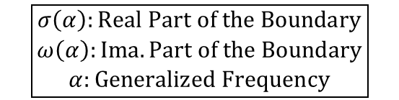

Gamma–Stability ($Γ$-Stability)
In the case of the left half plane, the boundary is described by
$$∂Γ≜\left\{s | s=jω, 0≤ω<∞\right\}$$
The boundary $∂Γ$ of the desired root region $Γ$ can be described by
$$∂Γ≜\left\{s | s=σ\left(α\right)+jω(α), α^{−}≤α≤α^{+}\right\}$$
$$\boxed{\begin{matrix}σ\left(α\right):Real Part of the Boundary \\ ω\left(α\right):Ima. Part of the Boundary \\ α:Generalized Frequency\end{matrix}}$$
Notes:
Gamma-Stability

Slide 9
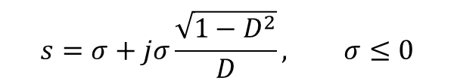
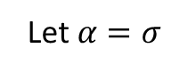
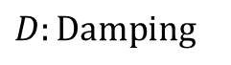
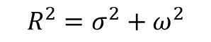
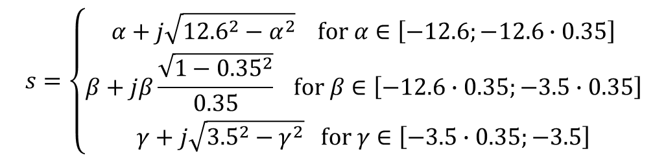
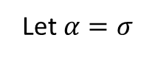
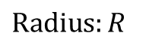

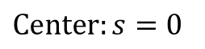
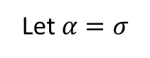
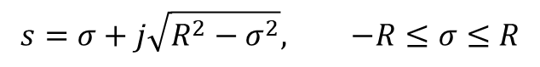
Gamma–Stability ($Γ$-Stability)
Lines of Constant Dampings
Interval of Two Real Root Boundaries
Circle
$$D:Damping$$
$$Center:s=0$$
$$Radius:R$$
Let $α=σ$
Let $α=σ$
$$R^{2}=σ^{2}+ω^{2}$$
$$s=σ+jσ\frac{\sqrt{1−D^{2}}}{D}, σ≤0$$
Let $α=σ$
$$s=σ, −b≤σ≤−a$$
$$s=σ+j\sqrt{R^{2}−σ^{2}}, −R≤σ≤R$$
$$s=\left\{\begin{matrix}α+j\sqrt{{12.6}^{2}−α^{2}} for α∈\left[−12.6;−12.6∙0.35\right] \\ β+jβ\frac{\sqrt{1−{0.35}^{2}}}{0.35} for β∈\left[−12.6∙0.35;−3.5∙0.35\right] \\ γ+j\sqrt{{3.5}^{2}−γ^{2}} for γ∈\left[−3.5∙0.35;−3.5\right]\end{matrix}\right.$$
Notes:
Gamma-Stability (2)

Slide 10
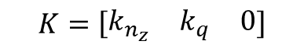

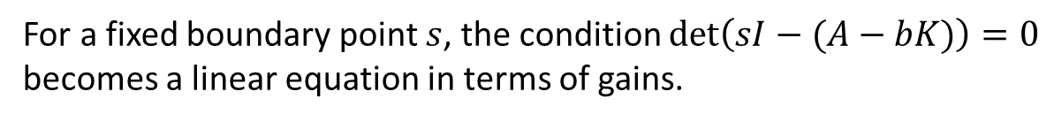
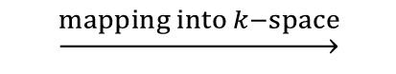
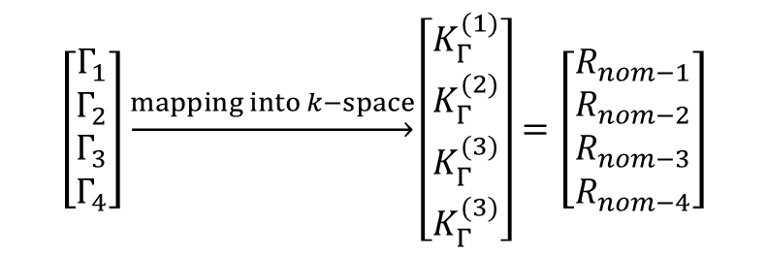

Pole Region Assignment and D-Decomposition
We know what we want. How do we get it?
$$\left[\begin{matrix}Γ_{1} \\ Γ_{2} \\ \begin{matrix}Γ_{3} \\ Γ_{4}\end{matrix}\end{matrix}\right]\underset{→}{mapping into k−space}\left[\begin{matrix}K_{Γ}^{(1)} \\ K_{Γ}^{(2)} \\ \begin{matrix}K_{Γ}^{(3)} \\ K_{Γ}^{(3)}\end{matrix}\end{matrix}\right]=\left[\begin{matrix}R_{nom−1} \\ R_{nom−2} \\ \begin{matrix}R_{nom−3} \\ R_{nom−4}\end{matrix}\end{matrix}\right]$$
$$\underset{→}{mapping into k−space}$$
Our Control Law
$$u=−Kx$$
For a fixed boundary point $s$, the condition $\det\left(sI−(A−bK)\right)=0$ becomes a linear equation in terms of gains.
$$K=\left[\begin{matrix}k_{n_{z}} & k_{q} & 0\end{matrix}\right]$$
$$A_{cl}=A−bK$$
Notes:
D-Decomposition

Slide 11
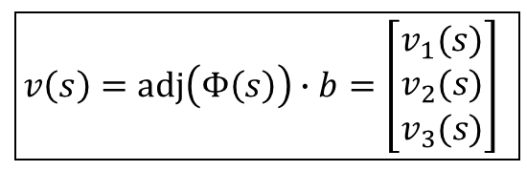
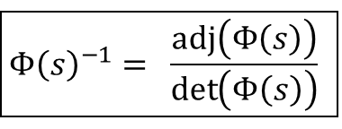
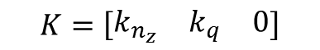
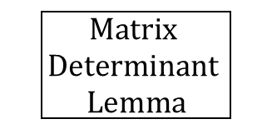
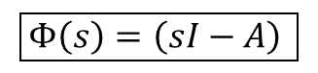
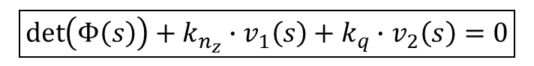
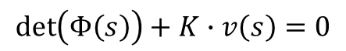

D-Decomposition (continued)
$$\det\left(sI−(A−bK)\right)=0$$
$$\boxed{\begin{aligned}Matrix \\ Determinant \\ Lemma\end{aligned}}$$
$$\det\left((sI−A)+bK)\right)=\det\left(sI−A\right)∙\left(1+K{\left(sI−A\right)}^{−1}b\right)=0$$
$$\boxed{Φ\left(s\right)=\left(sI−A\right) }$$
$$\det\left(Φ\left(s\right)+bK\right)=\det\left(Φ\left(s\right)\right)∙\left(1+K{Φ\left(s\right)}^{−1}b\right)=0$$
$$\boxed{Φ{\left(s\right)}^{−1}= \frac{adj\left(Φ\left(s\right)\right)}{\det\left(Φ\left(s\right)\right)} }$$
$$\det\left(Φ\left(s\right)\right)+K∙adj\left(Φ\left(s\right)\right)∙b=0$$
$$\boxed{v\left(s\right)=adj\left(Φ\left(s\right)\right)∙b=\left[\begin{matrix}v_{1}(s) \\ v_{2}(s) \\ v_{3}(s)\end{matrix}\right] }$$
$$\det\left(Φ\left(s\right)\right)+K∙v\left(s\right)=0$$
$$K=\left[\begin{matrix}k_{n_{z}} & k_{q} & 0\end{matrix}\right]$$
$$\boxed{\det\left(Φ\left(s\right)\right)+k_{n_{z}}∙v_{1}\left(s\right)+k_{q}∙v_{2}\left(s\right)=0}$$
Notes:
D-Decomposition (2)

Slide 12

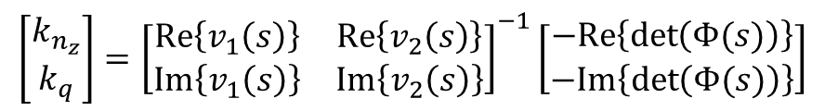

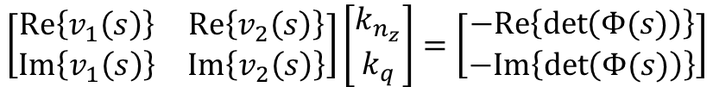
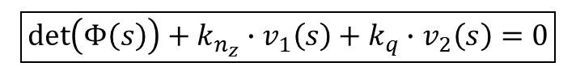

D-Decomposition (continued)
$$\boxed{\det\left(Φ\left(s\right)\right)+k_{n_{z}}∙v_{1}\left(s\right)+k_{q}∙v_{2}\left(s\right)=0}$$
$$\left[\begin{matrix}Re\left\{v_{1}\left(s\right)\right\} & Re\left\{v_{2}\left(s\right)\right\} \\ Im\left\{v_{1}\left(s\right)\right\} & Im\left\{v_{2}\left(s\right)\right\}\end{matrix}\right]\left[\begin{matrix}k_{n_{z}} \\ k_{q}\end{matrix}\right]=\left[\begin{matrix}−Re\left\{\det\left(Φ(s)\right)\right\} \\ −Im\left\{\det\left(Φ(s)\right)\right\}\end{matrix}\right]$$
Flying Qualities
Physical and Stability Limits
Complex Root Boundaries
Real Root Boundaries
To calculate $ζ$ and $ω$ borders
To calculate $σ$ borders
$$\left[\begin{matrix}k_{n_{z}} \\ k_{q}\end{matrix}\right]={\left[\begin{matrix}Re\left\{v_{1}\left(s\right)\right\} & Re\left\{v_{2}\left(s\right)\right\} \\ Im\left\{v_{1}\left(s\right)\right\} & Im\left\{v_{2}\left(s\right)\right\}\end{matrix}\right]}^{−1}\left[\begin{matrix}−Re\left\{\det\left(Φ(s)\right)\right\} \\ −Im\left\{\det\left(Φ(s)\right)\right\}\end{matrix}\right]$$
$$s=σ$$
$$\det\left(σI−A\right)+k_{n_{z}}∙v_{1}\left(σ\right)+k_{q}∙v_{2}\left(σ\right)=0$$
produces curve
produces straight line
Notes:
D-Decomposition (3)

Slide 13


Admissible Gain Regions
$$R_{nom−1}$$
$$R_{nom−2}$$
Notes:
Admissible Gain Regions

Slide 14


Admissible Gain Regions (continued)
$$R_{nom−3}$$
$$R_{nom−4}$$
Notes:
Admissible Gain Regions (2)

Slide 15

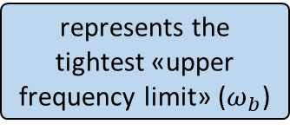
Admissible Gain Regions (continued)
high-frequency structural models
represents the tightest «upper frequency limit» ($ω_{b}$)
$R_{nom}=R_{nom−1}∩R_{nom−2}∩$ $R_{nom−3}∩$ $R_{nom−4}$
$$Q_{1}=\left[\begin{matrix}−0.115 & −0.8\end{matrix}\right]$$
Notes:
Admissible Gain Regions (3)

Slide 16
Robust Design Point ($Q_{1}$) and Results
Notes:
Robust Design Point ($Q_{1}$) and Results

Slide 17



Robust Design Point ($Q_{1}$) and Results (ctd.)
$$Evaluation of the Step Response: c^{∗}=\left(n_{z}+12.43q\right)/c_{∞}$$
Notes:
Robust Design Point ($Q_{1}$) and Results (2)

Slide 18
Robust Design Point ($Q_{1}$) and Results (ctd.)
Notes:
Robust Design Point ($Q_{1}$) and Results (3)

Slide 19




Robustness w.r.t. Sensor Failures
In the nominal case, both pitch rate ($q$) and normal acceleration $(n_{z})$ are used for feedback. In practice, accelerometer sensors may degrade or partially fail.
This degradation is modeled as a reduction in sensor gain:
Nominal sensor: $k=1$
Degraded sensor: $k=\frac{1}{2},\frac{2}{3}$, $\frac{1}{3}$
Problem
Direct use of the measured$n_{z}$under sensor degradation reduces robustness and leads to poor closed-loop performance.
Idea
Do not directly use the measured $N_{z}$. Estimate $N_{z}$from pitch rate $q$, which is more reliable.
Notes:
Robustness w.r.t. Sensor Failures

Slide 20



Robustness w.r.t. Sensor Failures (ctd.)
Model-Based Estimation of $N_{z}$
The transfer functions from elevator input ($u$) to pitch rate ($q$) and to normal acceleration $(N_{z}$) are derived from the same aircraft model. Therefore:
Both transfer functions have the same denominator
They share the same aircraft dynamics and poles
The difference is only in the numerators. Taking the ratio eliminates the common dynamics:
$$\frac{N_{z}\left(s\right)}{q\left(s\right)}=\frac{N_{z}\left(s\right)/u\left(s\right)}{q\left(s\right)/u\left(s\right)}$$
Using the aircraft model, the estimation transfer function is obtained as:
$$\frac{{\hat{N}}_{z}\left(s\right)}{q\left(s\right)}=0.543 \frac{s^{2}+1.172s+49.9}{s+0.98}$$
This transfer function represents the dominant dynamic relation between $q$ and $N_{z}$.
Notes:
Robustness w.r.t. Sensor Failures (2)

Slide 21



Robustness w.r.t. Sensor Failures (ctd.)
Realizability and Simulation Results
The estimation transfer function is not realizable due to its numerator order. To make it realizable, a first-order filter is added:
$$\frac{10}{s+10}$$
The final estimation transfer function becomes:
$$\boxed{\frac{{\hat{N}}_{z}\left(s\right)}{q\left(s\right)}=0.543 \frac{s^{2}+1.172s+49.9}{s+0.98} ∙\frac{10}{s+10}}$$
Closed-loop simulations are performed for four flight conditions (FC1–FC4). Two cases are compared:
Nominal sensor: $k=1$
Degraded sensor: $k=\frac{1}{2}$
Results
Although sensor degradation leads to slower response and lower damping, the system remains stable and satisfies the required pole-region constraints.
Notes:
Robustness w.r.t. Sensor Failures (3)

Slide 22

Robustness w.r.t. Sensor Failures (ctd.)
Closed-Loop Simulation Results FC-1
Notes:
Robustness w.r.t. Sensor Failures (4)

Slide 23

Robustness w.r.t. Sensor Failures (ctd.)
Closed-Loop Simulation Results FC-2
Notes:
Robustness w.r.t. Sensor Failures (5)

Slide 24

Robustness w.r.t. Sensor Failures (ctd.)
Closed-Loop Simulation Results FC-3
Notes:
Robustness w.r.t. Sensor Failures (6)

Slide 25

Robustness w.r.t. Sensor Failures (ctd.)
Closed-Loop Simulation Results FC-4
Notes:
Robustness w.r.t. Sensor Failures (7)

Slide 26
Conclusion
It has been demonstrated that a fixed-gain controller exhibits successful performance across significantly diverse flight conditions.
It has also been demonstrated that measurements by gyros alone are not only more cost-effective but actually provide some advantages for the control system stability.
Although results for the linearized models are robust, we must acknowledge that linear stability does not always imply nonlinear stability. Therefore, the next vital step is to perform comprehensive nonlinear simulations to confirm
Notes:
Conclusion

Slide 27

Cem Doğut's Award-Winning Photograph (2024), From the 50th Anniversary Celebration of the Turkish Air Force's F4-E Phantom II
Thank You for Your Attention!
Emir Arda Kılıç
504251113
İsmet Erdoğan
040200522
Notes:
Thank You for Your Attention!

